Slide 1


<Nor-Arevian Georgii>
<3/5/2025>

Slide 2

Outline
Executive Summary
Introduction
Methodology
Results
Conclusion
Appendix

Slide 3
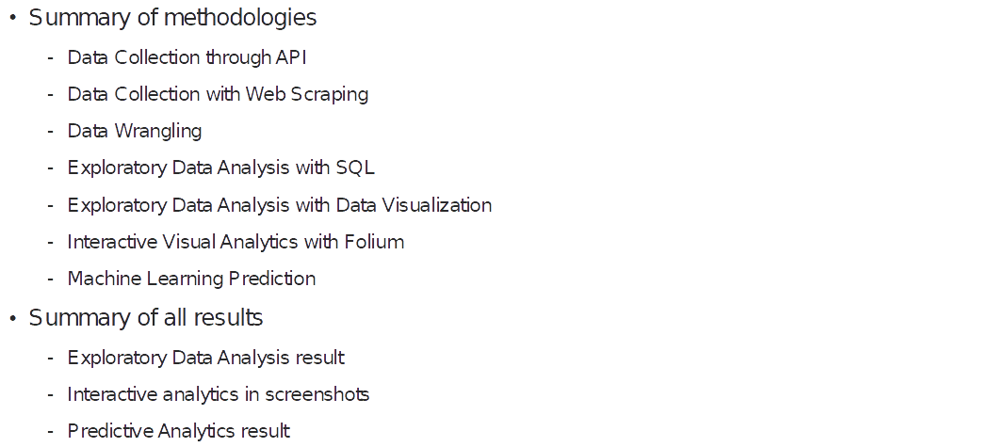
Executive Summary

Slide 4
Introduction
SpaceX advertises Falcon 9 rocket launches on its website with a cost of 62 million dollars; other providers cost upward of 165 million dollars each, much of the savings is because SpaceX can reuse the first stage.
We will predict if the Falcon 9 first stage will land successfully. What launch features impact for success landing.

Slide 5

Section 1

Slide 6
Data Collection
In this project we work with SpaceX launch data that is gathered from an API, specifically the SpaceX REST API. This API give us data about launches, including information about the rocket used, payload delivered, launch specifications, landing specifications, and landing outcome.
The SpaceX REST API endpoints, or URL, starts with api.spacexdata.com/v4/.
We have the different end points, for example: /capsules and /cores
We work with the endpoint api.spacexdata.com/v4/launches/past.
We use this URL to target a specific endpoint of the API to get past launch data.
We perform a get request using the requests library to obtain the launch data, which we use to get the data from the API.
This result can be viewed by calling the .json() method.
Our response will be in the form of a JSON, specifically a list of JSON objects.
Specifically, we have a list of JSON objects which each represent a launch.
To convert this JSON to a dataframe, we can use the json_normalize function.
This function will allow us to “normalize” the structured json data into a flat table.

Slide 7
Another popular data source for obtaining Falcon 9 Launch data is web scraping related Wiki pages.
We use the Python BeautifulSoup package to web scrape some HTML tables that contain valuable Falcon 9 launch records.
Then we need to parse the data from those tables and convert them into a Pandas data frame for further visualization and analysis.
We transform this raw data into a clean dataset which provides meaningful data on the situation we are trying to address:
Wrangling Data using an API,
Sampling Data, and
Dealing with Nulls.
In some of the columns, like rocket, we have an identification number, not actual data.
This means we need to use the API again targeting another endpoint to gather specific data for each ID number.
We use auxiliary functions that will use the following:
Booster,
Launchpad,
payload, and
core.
The data stored in lists and used to create our dataset.
Another issue we have is that the launch data we have includes data for the Falcon 1 booster whereas we only want falcon 9. We filter the data to remove Falcon 1 launches.
Finally, not all gathered data is perfect. We replace the null values in PayloadMass with the mean of the PayloadMass data. We leave the column LandingPad with NULL values, as it is represented when a landing pad is not used.

Slide 8
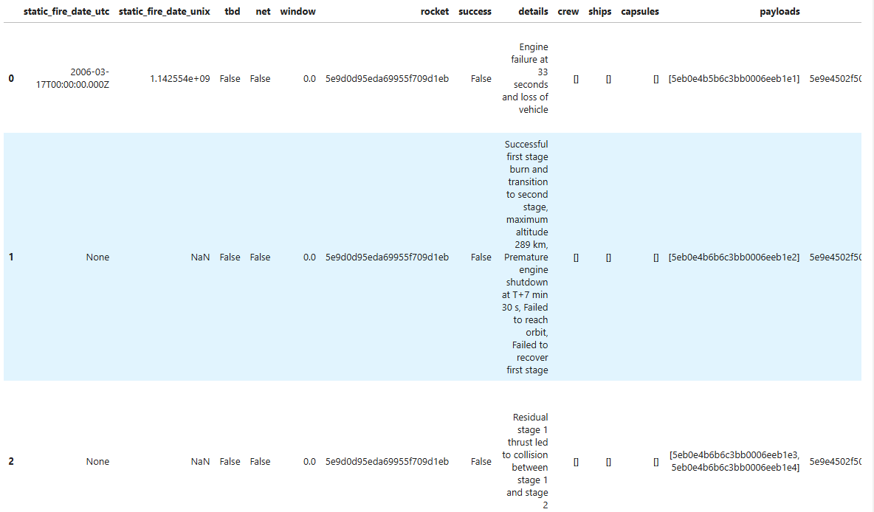
The following Dataframe have been collected.

Slide 9
Data Collection – SpaceX API
Start
SpaceX offers a public API from where data can be obtained
The completed SpaceX API calls notebook https://github.com/Georgii101/Applied-Data-Science-Capstone/blob/main/jupyter-labs-spacex-data-collection-api.ipynb
spacex_url="https://api.spacexdata.com/v4/launches/past"
convert the date_utc to a datetime datatype and then extracting the date leaving the time
Collect all data into the dictionary launch_dict
Request to the SpaceX API
restrict the dates of the launches by date(2020, 11, 13)]
Create a data frame from launch_dict
json_normalize meethod to convert the json result into a dataframe
Takes the booster names from API /rockets/
remove the Falcon 1 launches keeping only the Falcon 9 launches
take a subset of our dataframe keeping only the features we want
From the API launchpad take the name of the launch site, the logitude, and the latitude.
replace the null values in PayloadMass with the mean of the PayloadMass data
remove rows with multiple cores
From the API payload take the mass of the payload and the orbit
Finish
extract the single value in the list and replace the feature
From API cores take data.

Slide 10
Data Collection - Scraping
Start
WEB scraping to collect Falcon 9 historical launch records from a Wikipedia page titled `List of Falcon 9 and Falcon Heavy launches https://en.wikipedia.org/wiki/List_of_Falcon_9_and_Falcon_Heavy_launches
WEB scraping notebook https://github.com/Georgii101/Applied-Data-Science-Capstone/blob/main/jupyter-labs-webscraping.ipynb
static_url = "https://en.wikipedia.org/w/index.php?title=List_of_Falcon_9_and_Falcon_Heavy_launches&oldid=1027686922"
extract column names
Request the Falcon9 Launch Wiki page
Create empty dictionary with column names
find all tables on the wiki page
Parsing and copying data from HTML into dictionary.
Get the third table
first_launch_table = html_tables[2]
Convert dictionary into dataframe
Finish

Slide 11
Data Wrangling
In the dataframe there is the column Outcome indicates if the first stage successfully landed.
There are 8 of them:
-True Ocean means the mission outcome was successfully landed to a specific region of the ocean while False Ocean means the mission outcome was unsuccessfully landed to a specific region of the ocean.
-True RTLS means the mission outcome was successfully landed to a ground pad False RTLS means the mission outcome was unsuccessfully landed to a ground pad.
-True ASDS means the mission outcome was successfully landed to a drone ship False ASDS means the mission outcome was unsuccessfully landed to a drone ship.
-None ASDS and None None these represent a failure to land.
,We would like landing outcomes to be converted to Classes (either 0 or 1).
0 is a bad outcome, that is, the booster did not land.
1 is a good outcome, that is, the booster did land.
The notebook in the GitHub https://github.com/Georgii101/Applied-Data-Science-Capstone/blob/main/labs-jupyter-spacex-Data%20wrangling.ipynb
Start
Determine the number of landing_outcomes landing_outcomes = df['Outcome'].value_counts()
Create a set of outcomes where the second stage did not land successfully
{'False ASDS', 'False Ocean', 'False RTLS', 'None ASDS', 'None None'}
create a list where the element is zero if the corresponding row in Outcome is in the set bad_outcome; otherwise, it's one.
Copy these values into the dataframe
df['Class']=landing_class
Finish
11

Slide 12
EDA with Data Visualization
The following charts were plotted:
plot the FlightNumber vs. PayloadMass
the relationship between Flight Number and Launch Site
the relationship between Payload Mass and Launch Site
the relationship between success rate of each orbit type
the relationship between FlightNumber and Orbit type
the relationship between Payload Mass and Orbit type
the launch success yearly trend
EDA with data visualization notebook https://github.com/Georgii101/Applied-Data-Science-Capstone/blob/main/edadataviz.ipynb

Slide 13
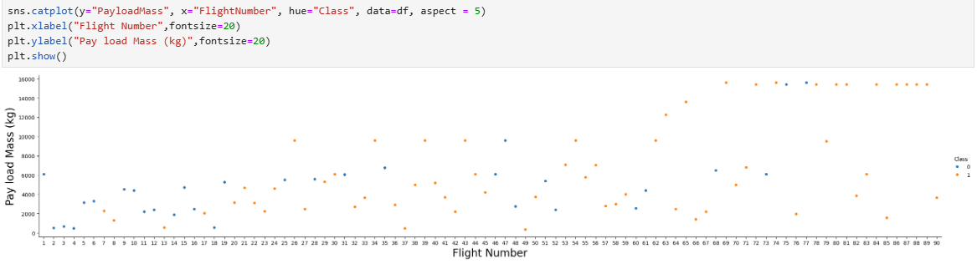
We see that as the flight number increases, the first stage is more likely to land successfully. The payload mass also appears to be a factor; even with more massive payloads, the first stage often returns successfully.

Slide 14
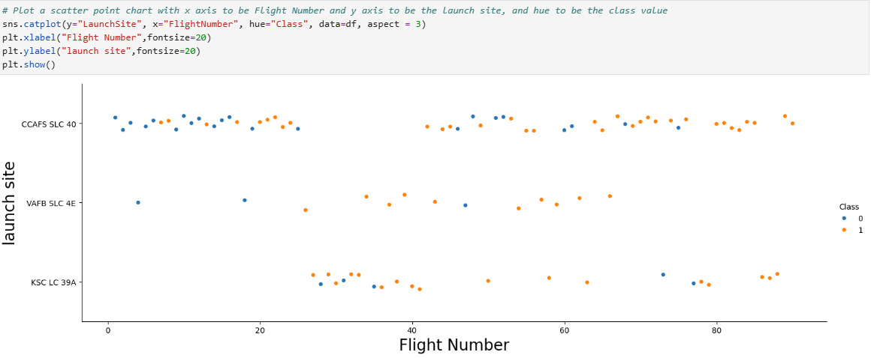
We see that for each site as the flight number increases, the first stage is more likely to land successfully.

Slide 15
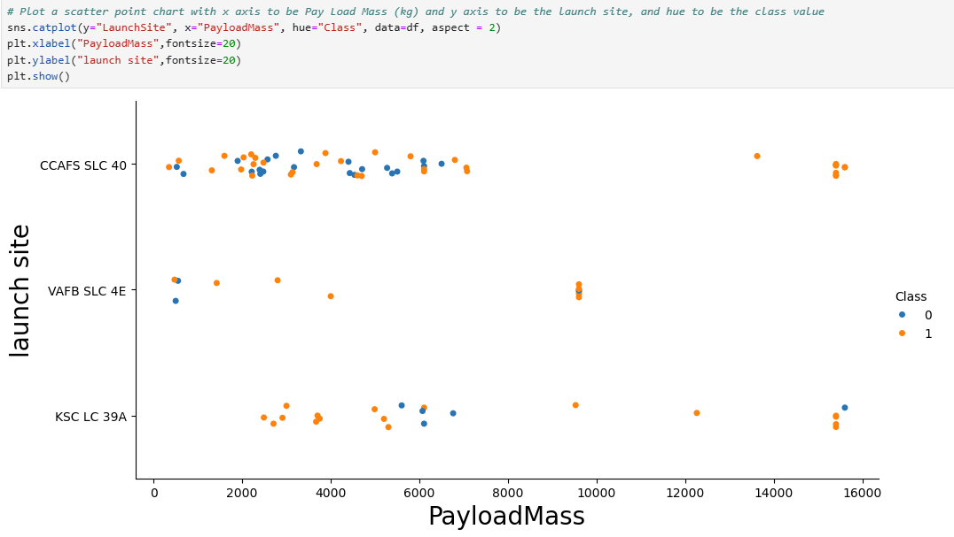
Now if you observe Payload Mass Vs. Launch Site scatter point chart you will find for the VAFB-SLC launchsite there are no rockets launched for heavypayload mass(greater than 10000).

Slide 16
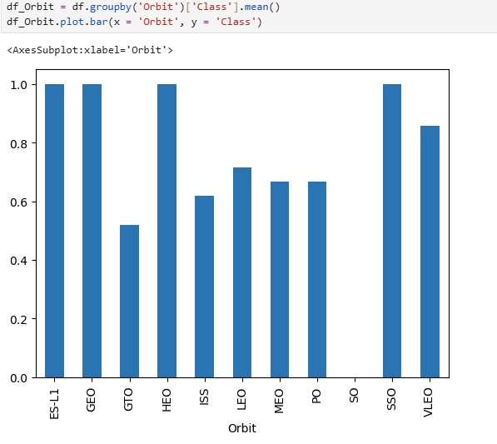
There are four orbit types for the most success launches: ES-L1, GEO, HEO, SSO.

Slide 17
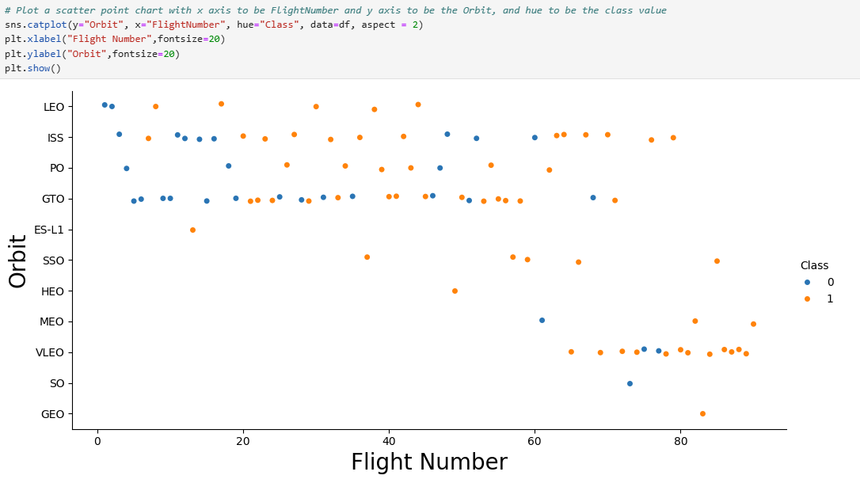
You can observe that in the LEO orbit, success seems to be related to the number of flights. Conversely, in the GTO orbit, there appears to be no relationship between flight number and success.

Slide 18
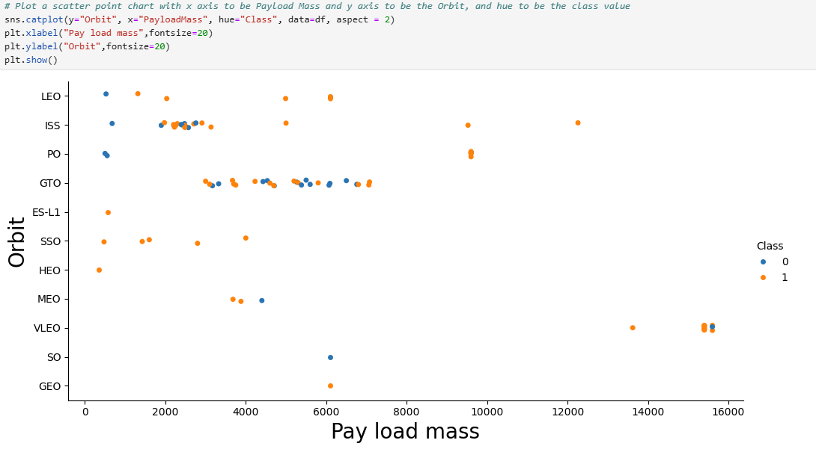
With heavy payloads the successful landing or positive landing rate are more for Polar,LEO and ISS.
However, for GTO, it's difficult to distinguish between successful and unsuccessful landings as both outcomes are present.

Slide 19
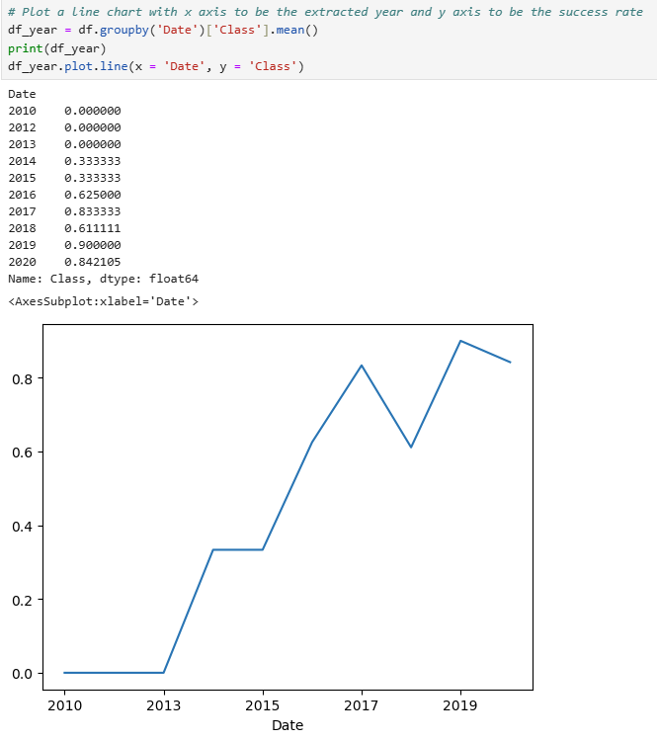
A line chart with x axis is the year and y axis is the success rate. You can observe that the sucess rate since 2013 kept increasing till 2020

Slide 20
EDA with SQL
The following SQL queries were perfomed:
the names of the unique launch sites in the space mission
5 records where launch sites begin with the string 'CCA'
the total payload mass carried by boosters launched by NASA (CRS)
average payload mass carried by booster version F9 v1.1
List the date when the first succesful landing outcome in ground pad was acheived.
List the names of the boosters which have success in drone ship and have payload mass greater than 4000 but less than 6000
List the total number of successful and failure mission outcomes
List the names of the booster_versions which have carried the maximum payload mass.
List the records which will display the month names, failure landing_outcomes in drone ship ,booster versions, launch_site for the months in year 2015.
Rank the count of landing outcomes (such as Failure (drone ship) or Success (ground pad)) between the date 2010-06-04 and 2017-03-20, in descending order.
EDA with SQL notebook https://github.com/Georgii101/Applied-Data-Science-Capstone/blob/main/jupyter-labs-eda-sql-coursera_sqllite.ipynb

Slide 21
The names of the unique launch sites in the space mission
Records where launch sites begin with the string 'CCA'
The total payload mass carried by boosters launched by NASA (CRS) = 45596
Average payload mass carried by booster version F9 v1.1 = 2928.4
Launch_Site
CCAFS LC-40
VAFB SLC-4E
KSC LC-39A
CCAFS SLC-40
Date | Time (UTC) | Booster_Version | Launch_Site | Payload | PAYLOAD_MASS__KG_ | Orbit | Customer | Mission_Outcome | Landing_Outcome
2010-06-04 | 18:45:00 | F9 v1.0 B0003 | CCAFS LC-40 | Dragon Spacecraft Qualification Unit | 0 | LEO | SpaceX | Success | Failure (parachute)
2010-12-08 | 15:43:00 | F9 v1.0 B0004 | CCAFS LC-40 | Dragon demo flight C1, two CubeSats, barrel of Brouere cheese | 0 | LEO (ISS) | NASA (COTS) NRO | Success | Failure (parachute)
2012-05-22 | 7:44:00 | F9 v1.0 B0005 | CCAFS LC-40 | Dragon demo flight C2 | 525 | LEO (ISS) | NASA (COTS) | Success | No attempt

Slide 22
The date when the first succesful landing outcome in ground pad was achieved is 2015-12-22
List the names of the boosters which have success in drone ship and have payload mass greater than 4000 but less than 6000
List the total number of successful and failure mission outcomes
Mission_Outcome count()
Failure (in flight) 1
Success 98
Success 1
Success (payload status unclear) 1
Booster_Version
F9 FT B1022
F9 FT B1026
F9 FT B1021.2
F9 FT B1031.2

Slide 23
The names of the booster_versions which have carried the maximum payload mass (15600).
Booster_Version PAYLOAD_MASS__KG_
F9 B5 B1048.4 15600
F9 B5 B1049.4 15600
F9 B5 B1051.3 15600
F9 B5 B1056.4 15600
F9 B5 B1048.5 15600
F9 B5 B1051.4 15600
F9 B5 B1049.5 15600
F9 B5 B1060.2 15600
F9 B5 B1058.3 15600
F9 B5 B1051.6 15600
F9 B5 B1060.3 15600
F9 B5 B1049.7 15600
The records which display the month, failure landing_outcomes in drone ship ,booster versions, launch_site for the months in year 2015.
Month Landing_Outcome Booster_Version Launch_Site
01 Failure (drone ship) F9 v1.1 B1012 CCAFS LC-40
04 Failure (drone ship) F9 v1.1 B1015 CCAFS LC-40

Slide 24
Rank the count of landing outcomes (such as Failure (drone ship) or Success (ground pad)) between the date 2010-06-04 and 2017-03-20, in descending order.
Landing_Outcome coun
Success 38
No attempt 21
Success (drone ship) 14
Success (ground pad) 9
Failure (drone ship) 5
Controlled (ocean) 5
Failure 3
Uncontrolled (ocean) 2
Failure (parachute) 2
Precluded (drone ship) 1
No attempt 1

Slide 25
Build an Interactive Map with Folium
Summarize what map objects such as markers, circles, lines, etc. you created and added to a folium map
Explain why you added those objects
Add the GitHub URL of your completed interactive map with Folium map, as an external reference and peer-review purpose

Slide 26
Build a Dashboard with Plotly Dash
Summarize what plots/graphs and interactions you have added to a dashboard
Explain why you added those plots and interactions
Add the GitHub URL of your completed Plotly Dash lab, as an external reference and peer-review purpose

Slide 27
Predictive Analysis (Classification)
We loaded the data using Numpy and Pandas, transformed the data, split data into training testing.
We built different machine learning models and tune different hyperparameters using GridSearchCV.
We used accuracy as the metric for our model, improved the model using feature engineering and algorithm tuning.
We found the best perfoming classification model.
The link to the notebook is https://github.com/Georgii101/Applied-Data-Science-Capstone/blob/main/SpaceX_Machine%20Learning%20Prediction.ipynb

Slide 28

Section 3

Slide 29
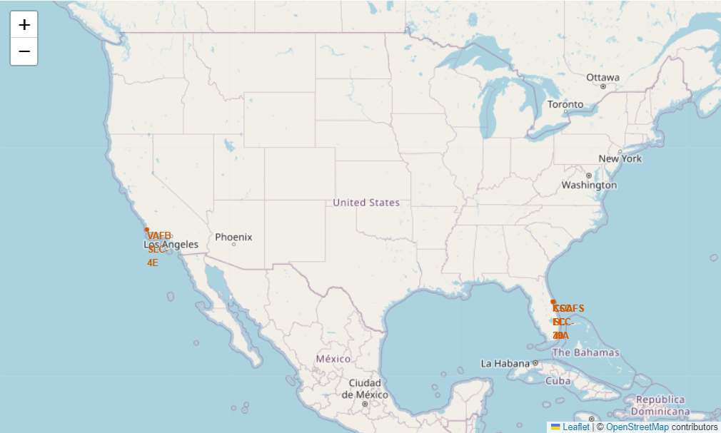
All launch sites are marked on a map.
The notebook with built map is https://github.com/Georgii101/Applied-Data-Science-Capstone/blob/main/lab_jupyter_launch_site_location.ipynb

Slide 30
We get up coordinates for four launch sites from dataset and put up them on the map. On the map we see three of them are located on East coast USA and next each from other. One is near of West coast.
 | Launch Site | Lat | Long
 | CCAFS LC-40 | 28.562302 | -80.577356
 | CCAFS SLC-40 | 28.563197 | -80.576820
 | KSC LC-39A | 28.573255 | -80.646895
 | VAFB SLC-4E | 34.632834 | -120.610745

Slide 31
Successes and failed launches on the map.
The map contains markers that show failed and successes launches. Red markers are failed and green are successes. For instance, on the map below for one of the launch sites we could view more red markers (failed launches) and a few successes.

Slide 32
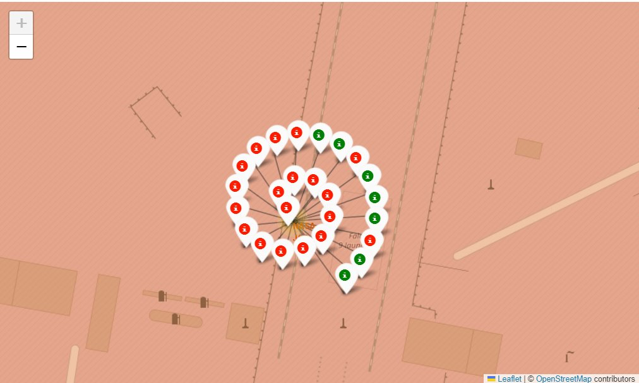

Slide 33
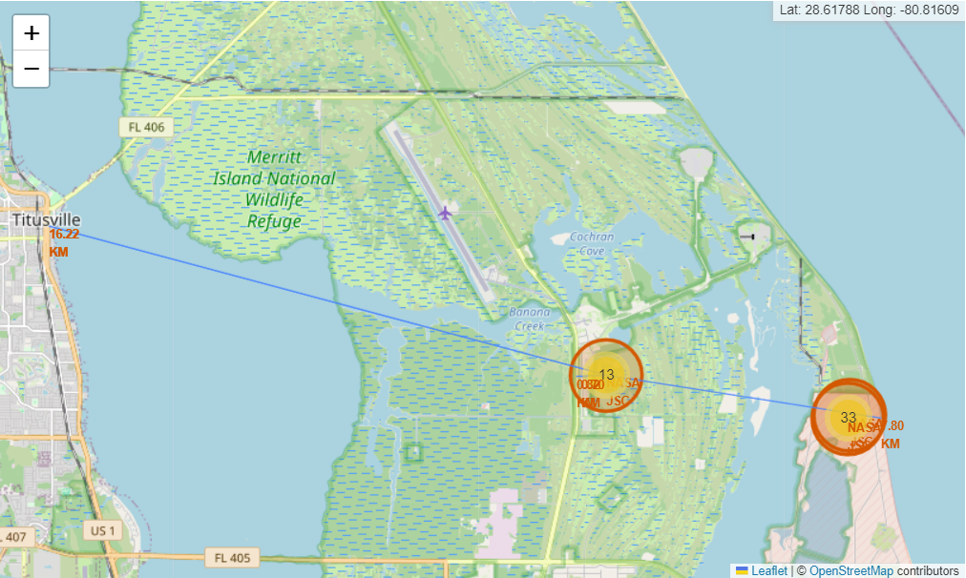
Distances from launch site to a closest city, railway, highway, etc.

Slide 34
On the map drawed lines from launch sites to some closest objects. The distanses are calculated and showed on the map.
To the nearest city Titusville 16 km
To railway 0.7 km
To highway 0.8 km
To coastline 7.8 km
The transport ways are next, this is convience.
The city is pretty far.

Slide 35

Section 4

Slide 36
The dashboard application contains input components such as a dropdown list and a range slider to interact with a pie chart and a scatter point chart.
The source Python text https://github.com/Georgii101/Applied-Data-Science-Capstone/blob/main/spacex_dash_app.py

Slide 37
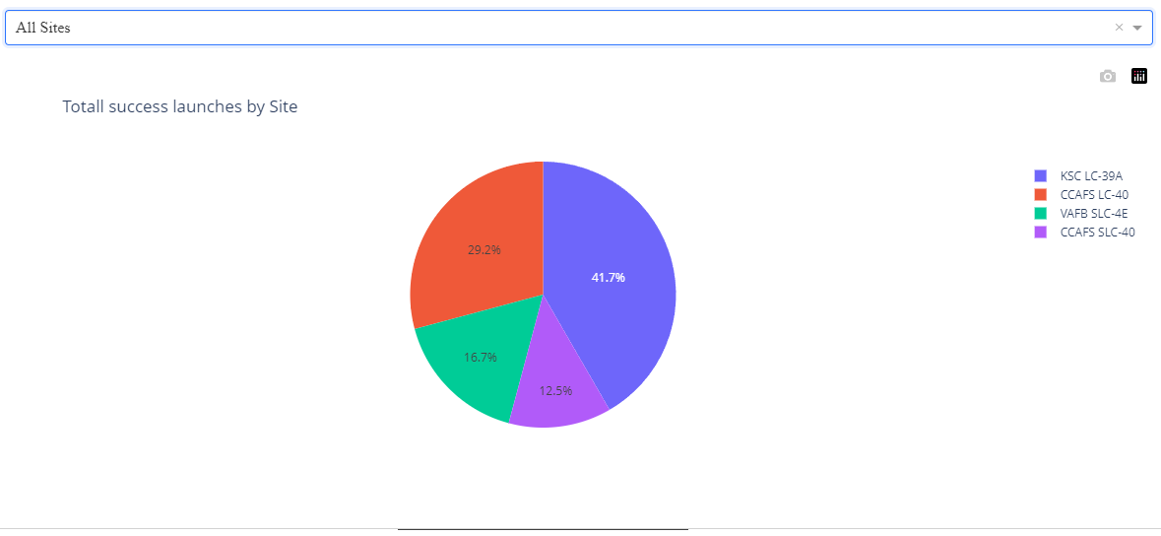
SpaceX Launch Records Dashboard

Slide 38
Piechart shows success launches from each site. We look that the most success launches (41.7%) was from KSC LC-39A. And if put mouse on this pie, we can see 10 success launches (class = 10).

Slide 39
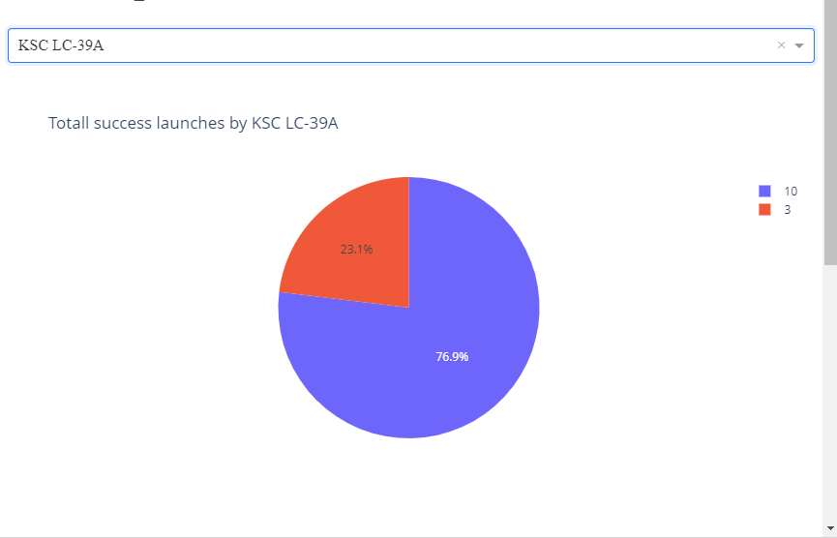
Total success launches for the launch site (KSC LC-39A) with highest launch success ratio
Site KSC LC-39A has 10(76.9%) success launches vs 3(23.1%). This is the most percent among all sites. Below we see percentages for other sites.
CCAFS LC-40 19(73.1% ) vs 7(26.9%)
CCAFS SLC-40 4(57.1%) vs 3(42.9%)
VAFB SLC-4E 6(60%) vs 4(40%)

Slide 40
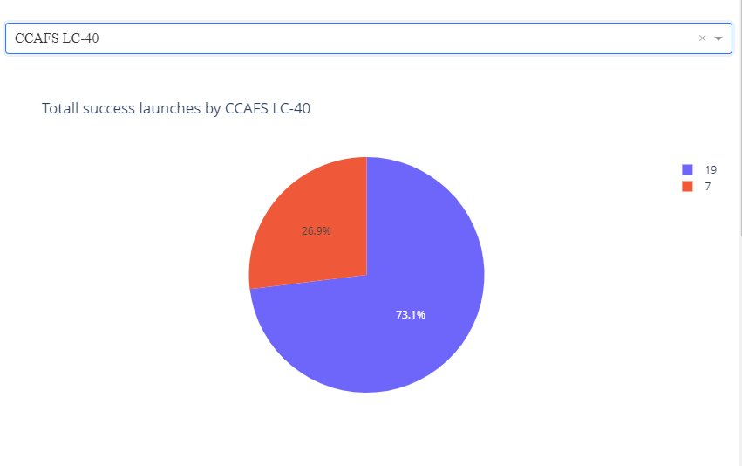
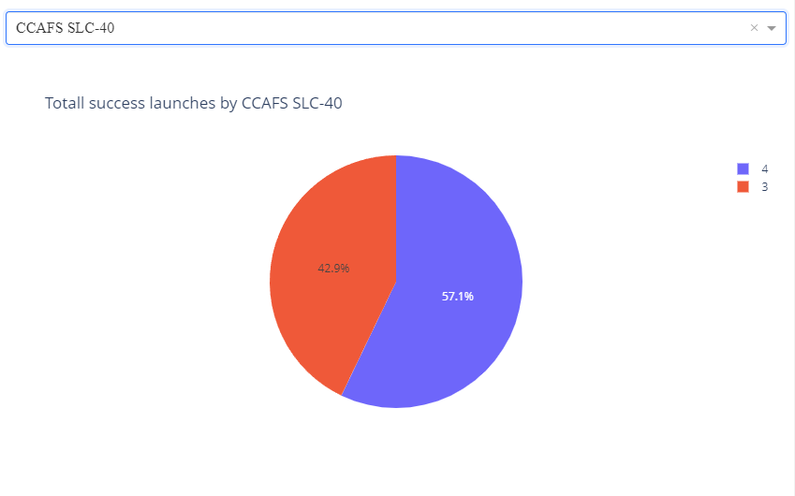
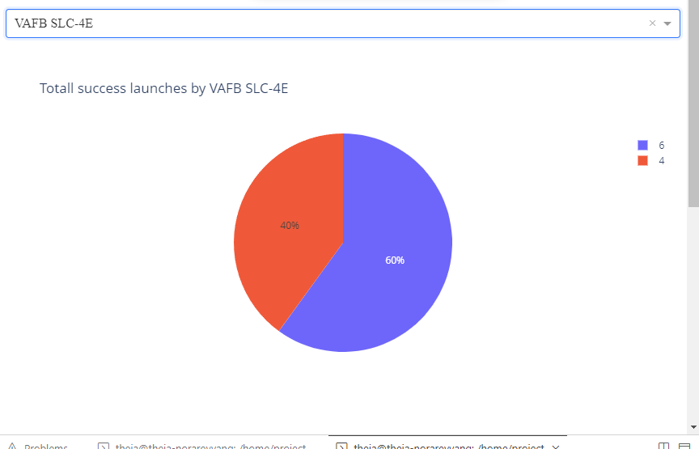

Slide 41
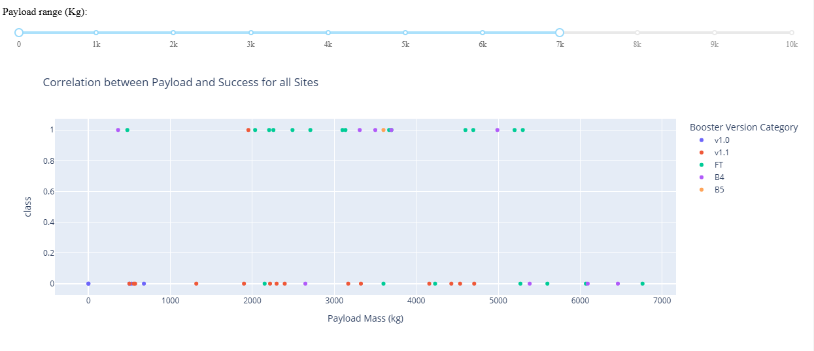
The F9 Booster FT (green color) has the highest success rate.

Slide 42
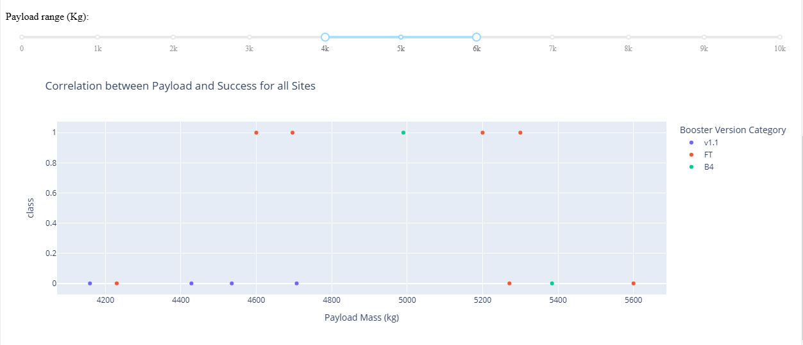
The range 4600-5300kg has 5 success vs 2 unsuccess and this is the highest success rate = 2.5.

Slide 43
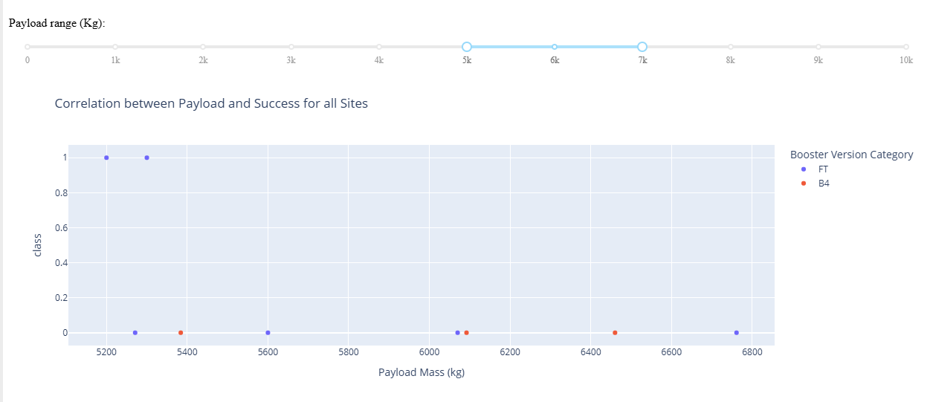
The range 5400-6800kg has 0 success and 6 unseccess launches.

Slide 44

Section 5

Slide 45
Classification Accuracy
There are built classification models for four methods.
Method Logistic_Reg SVM Decision Tree KNN Test Data Accuracy 0.833333 0.833333 0.888889 0.833333
The highest classification accuracy is 0.89 at Decision Tree Classifier model.
The notebook is https://github.com/Georgii101/Applied-Data-Science-Capstone/blob/main/SpaceX_Machine%20Learning%20Prediction.ipynb

Slide 46

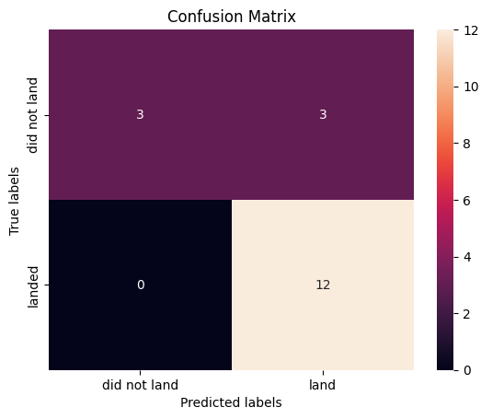
Confusion Matrix
The confusion matrix for logistic regression. | The confusion matrix for SVM.

Slide 47
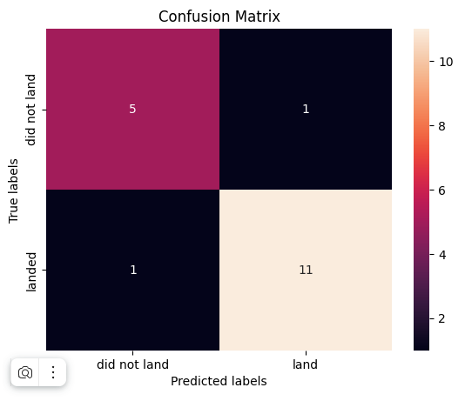
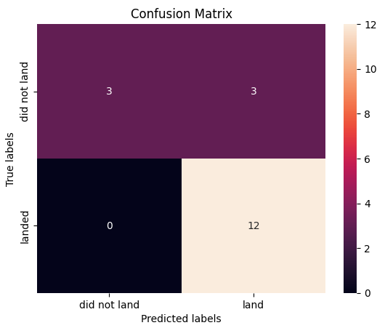
The confusion matrix for Decision Tree Classifier. | The confusion matrix for k nearest neighbors.

Slide 48
Conclusions
We can conclude that:
The larger the flight amount at a launch site, the greater the success rate at a launch site.
Launch success rate started to increase in 2013 till 2020.
Orbits ES-L1, GEO, HEO, SSO, VLEO had the most success rate.
KSC LC-39A had the most successful launches of any sites.
The Decision tree classifier is the best machine learning algorithm for this task.

Slide 49
Appendix
Assets for Launch Sites Proximities Analysis
# Select relevant sub-columns: `Launch Site`, `Lat(Latitude)`, `Long(Longitude)`, `class`
spacex_df = spacex_df[['Launch Site', 'Lat', 'Long', 'class']]
launch_sites_df = spacex_df.groupby(['Launch Site'], as_index=False).first()
launch_sites_df = launch_sites_df[['Launch Site', 'Lat', 'Long']]
launch_sites_df
 | Launch Site | Lat | Long
0 | CCAFS LC-40 | 28.562302 | -80.577356
1 | CCAFS SLC-40 | 28.563197 | -80.576820
2 | KSC LC-39A | 28.573255 | -80.646895
3 | VAFB SLC-4E | 34.632834 | -120.610745

Slide 50
Assets for Launch Sites Proximities Analysis
# Select relevant sub-columns: `Launch Site`, `Lat(Latitude)`, `Long(Longitude)`, `class`
spacex_df = spacex_df[['Launch Site', 'Lat', 'Long', 'class']]
launch_sites_df = spacex_df.groupby(['Launch Site'], as_index=False).first()
launch_sites_df = launch_sites_df[['Launch Site', 'Lat', 'Long']]
launch_sites_df
 | Launch Site | Lat | Long
0 | CCAFS LC-40 | 28.562302 | -80.577356
1 | CCAFS SLC-40 | 28.563197 | -80.576820
2 | KSC LC-39A | 28.573255 | -80.646895
3 | VAFB SLC-4E | 34.632834 | -120.610745

Slide 51
# For each launch site, add a Circle object based on its coordinate (Lat, Long) values.
for index, site in launch_sites_df.iterrows():
site_coordinates = [site['Lat'], site['Long']]
#print(site_coordinates)
circle = folium.Circle(site_coordinates, radius=1000, color='#d35400', fill=True).add_child(folium.Popup(site['Launch Site']))
marker = folium.map.Marker(
site_coordinates,
icon=DivIcon(
icon_size=(20,20),
icon_anchor=(0,0),
html='<div style="font-size: 12; color:#d35400;"><b>%s</b></div>' % site['Launch Site'],
)
)
site_map.add_child(circle)
site_map.add_child(marker)
site_map

Slide 52
# Apply a function to check the value of `class` column
# If class=1, marker_color value will be green
# If class=0, marker_color value will be red
spacex_df['marker_color'] = spacex_df['class'].apply(lambda x: 'green' if x == 1 else 'red')
# Add marker_cluster to current site_map
site_map.add_child(marker_cluster)
for index, record in spacex_df.iterrows():
# TODO: Create and add a Marker cluster to the site map
#marker = folium.Marker()
site_coordinates = [record['Lat'], record['Long']]
marker = folium.map.Marker(
site_coordinates,
icon=folium.Icon(color = 'white', icon_color = record['marker_color'])
)
marker_cluster.add_child(marker)
site_map

Slide 53
# Create a marker with distance to a closest city, railway, highway, etc. Draw a line between the marker to the launch site
city_lat = 28.61113 # Titusville
city_lon = -80.80727
distance = calculate_distance(launch_site_lat, launch_site_lon, city_lat, city_lon)
coordinate = [city_lat, city_lon]
distance_marker = folium.Marker(
coordinate,
icon=DivIcon(
icon_size=(20,20),
icon_anchor=(0,0),
html='<div style="font-size: 12; color:#d35400;"><b>%s</b></div>' % "{:10.2f} KM".format(distance),
)
)
site_map.add_child(distance_marker)
coordinates = [coordinate,[launch_site_lat,launch_site_lon]]
lines=folium.PolyLine(locations=coordinates, weight=1)
site_map.add_child(lines)
site_map

Slide 54
# Add a callback function for `site-dropdown` as input, `success-pie-chart` as output
@app.callback(Output(component_id='success-pie-chart', component_property='figure'),
Input(component_id='site-dropdown', component_property='value'))
def get_pie_chart(entered_site):
if entered_site == 'ALL':
data = spacex_df
fig = px.pie(data, values='class', # берем исходный dataframe, в px.pie указываем разбить по
names='Launch Site', # стартовым площадкам (names='Launch Site') значения class
# (values = 'class')
title='Totall success launches by Site')
return fig
else:
# return the outcomes piechart for a selected site
# отбираем по выбранной стартовой площадке и подсчитываем неудачные и удачные
# запуски (значение class).
# В легенде показывает количество удачных и неудачных (фиолетовый 6, красный 4),
# в отличие от приведенного скриншота, где фиолетовый 1, красный 0. Но у меня лучше.
data = spacex_df[spacex_df["Launch Site"] == entered_site].groupby(['class'])['class'].count()
fig = px.pie(data, values='class',
names='class',
title='Totall success launches by '+entered_site)
return fig

Slide 55


